Slide 1
AlgoExpert CSE 326 Information & System Design BPMN diagram
1805001 – Mehrab Haque
1805003 – Rabib Jahin Ibn Momin
1805009 – Md. Zarzees Uddin Shah
1805015 – Ahmed Mahir Sultan Rumi
1805021 – Abdus Samee
1805024 – Zannatul Nayeem

Slide 2
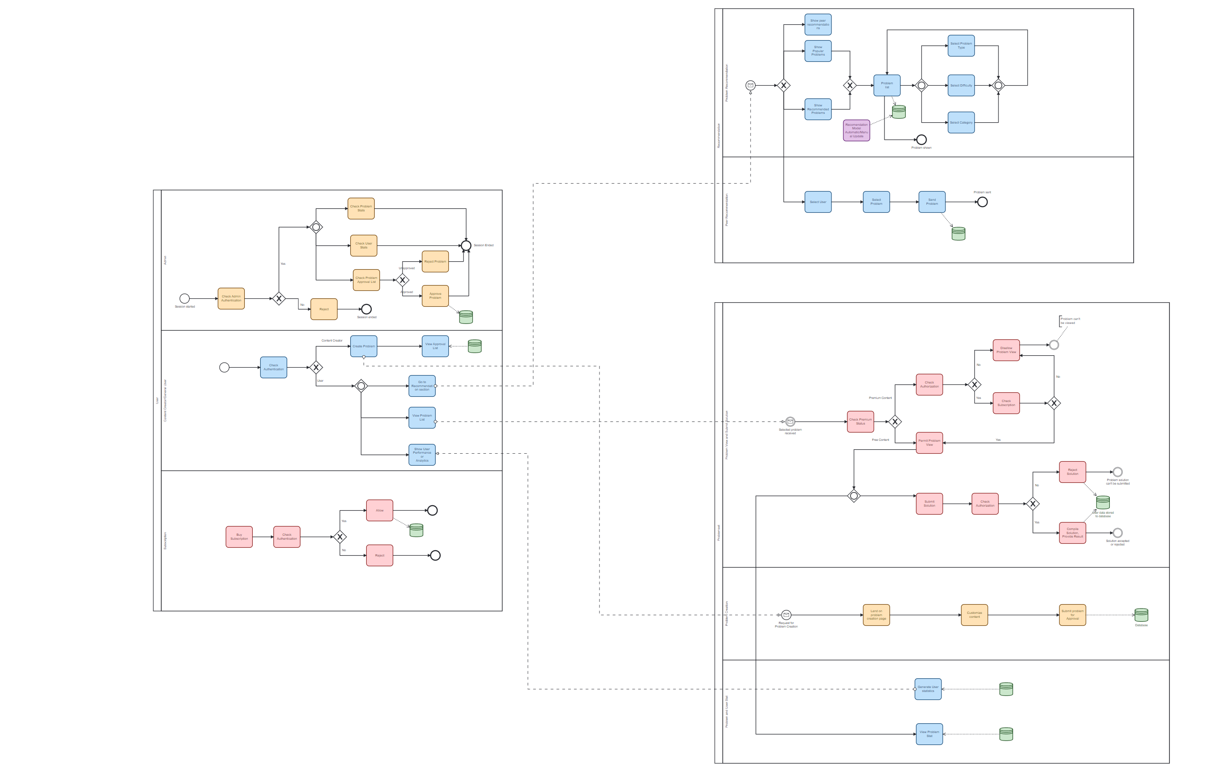
Full BPMN Diagram

Slide 3
Pools & Lanes
User
Admin
Content Creator/General User
Subscription
Problemset
Problem View/Submit Solution
Problem Creation
Problem & User Stat
Recommendation
Problem Recommendation
Peer Recommendation

Slide 4
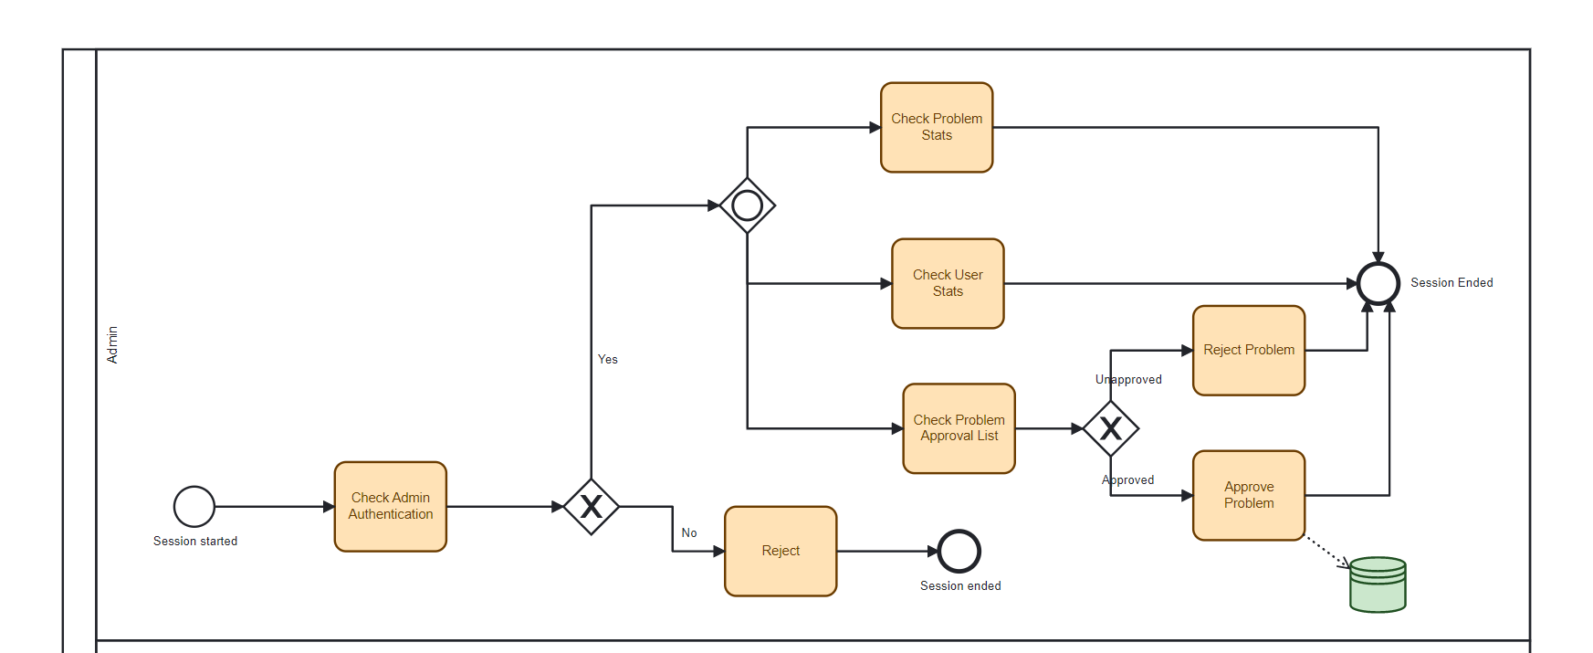
Admin

Slide 5
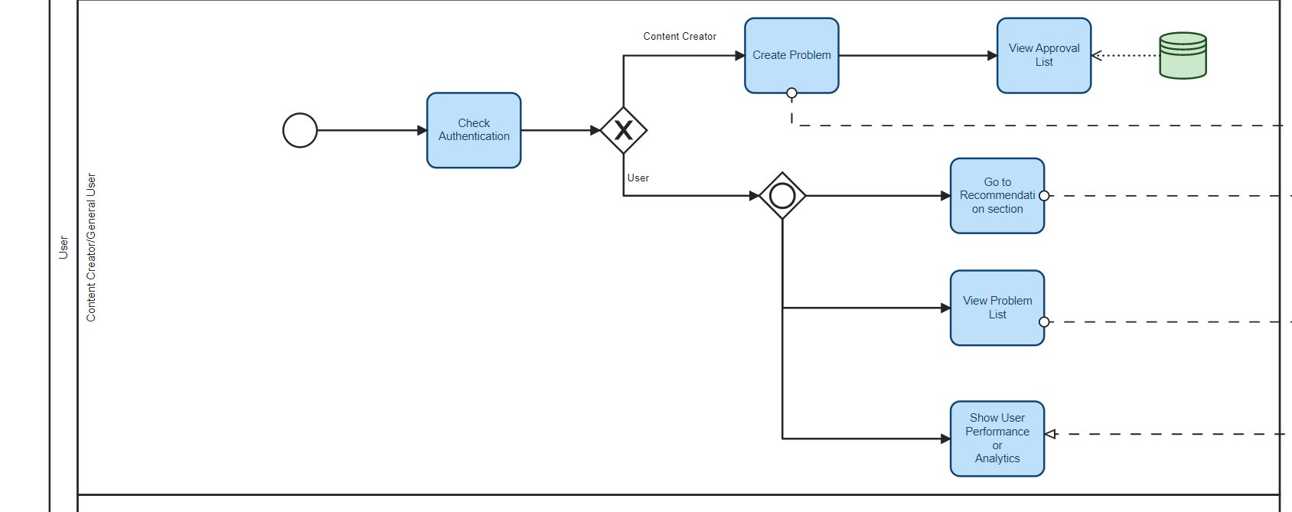
Content Creator/General User

Slide 6
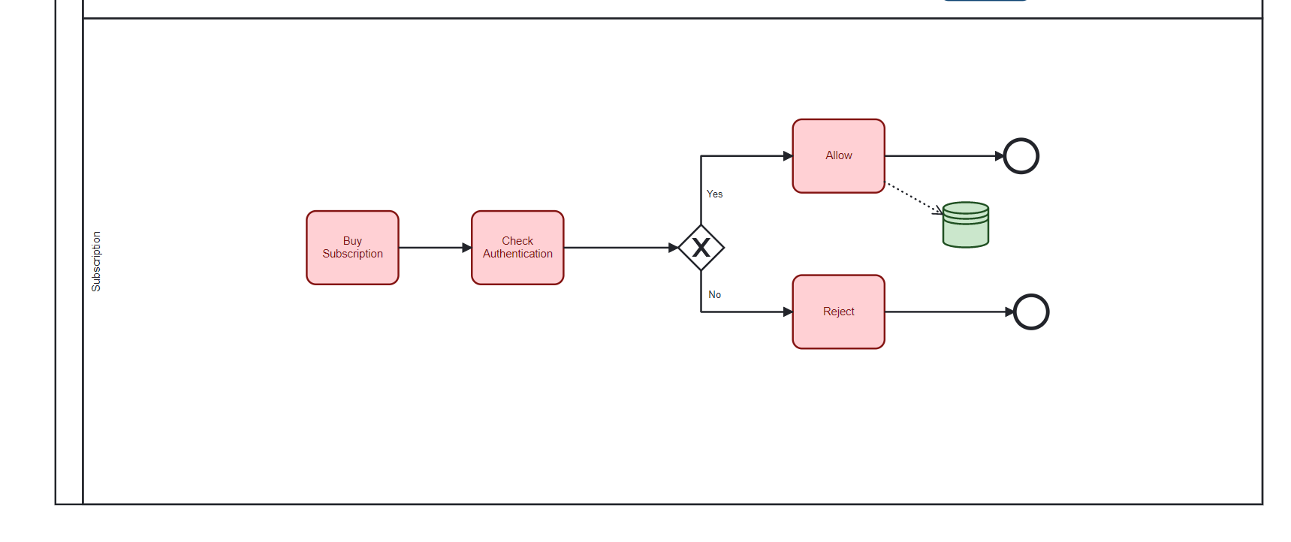
Subscription

Slide 7
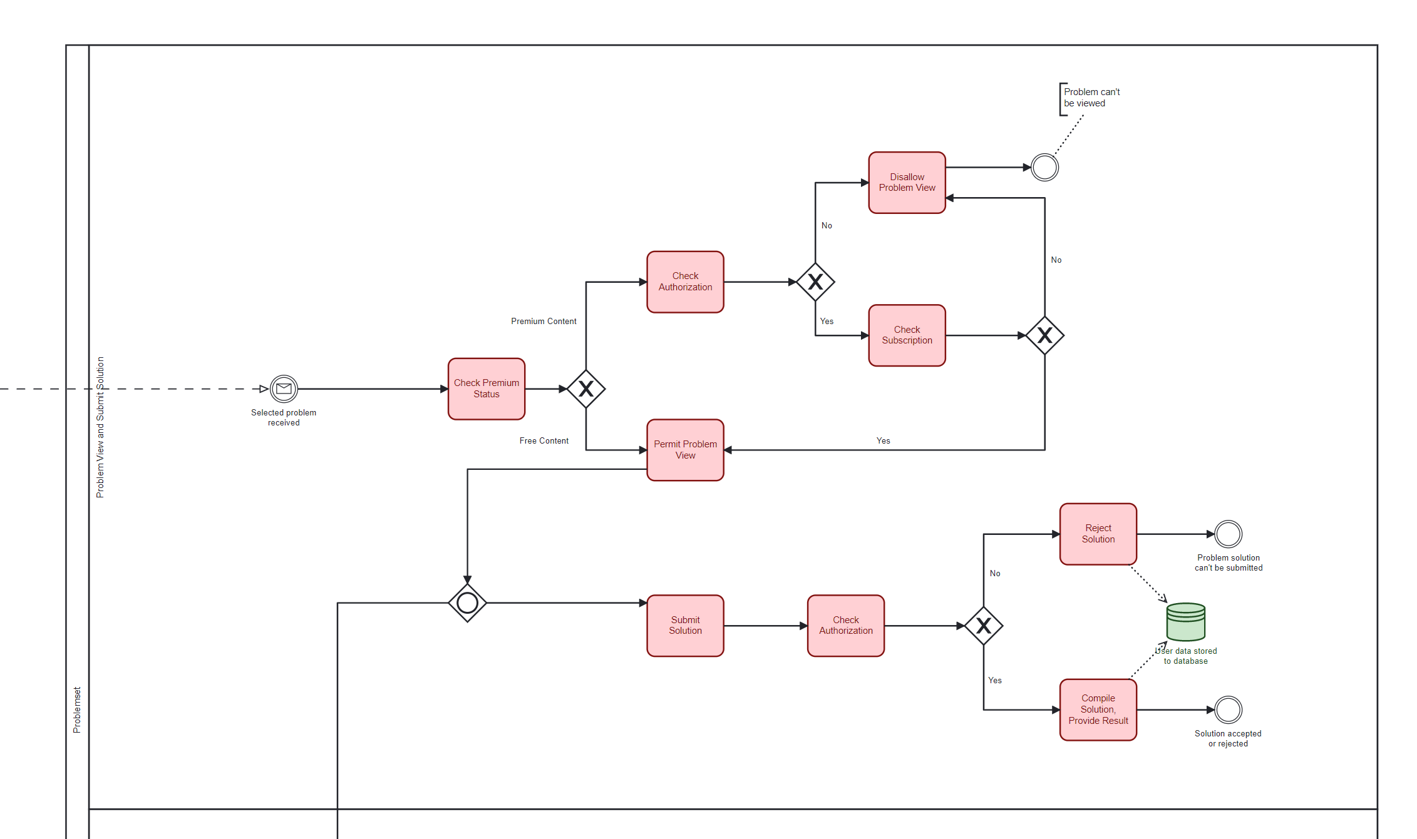
Problem View & Submit Solution

Slide 8
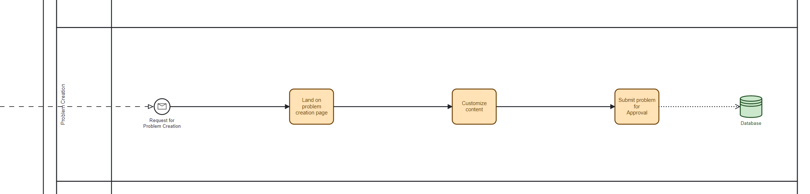
Problem Creation

Slide 9

Problem & User Stat

Slide 10
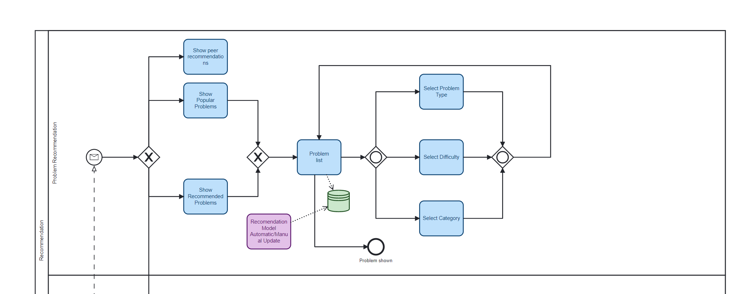
Problem Recommendation

Slide 11
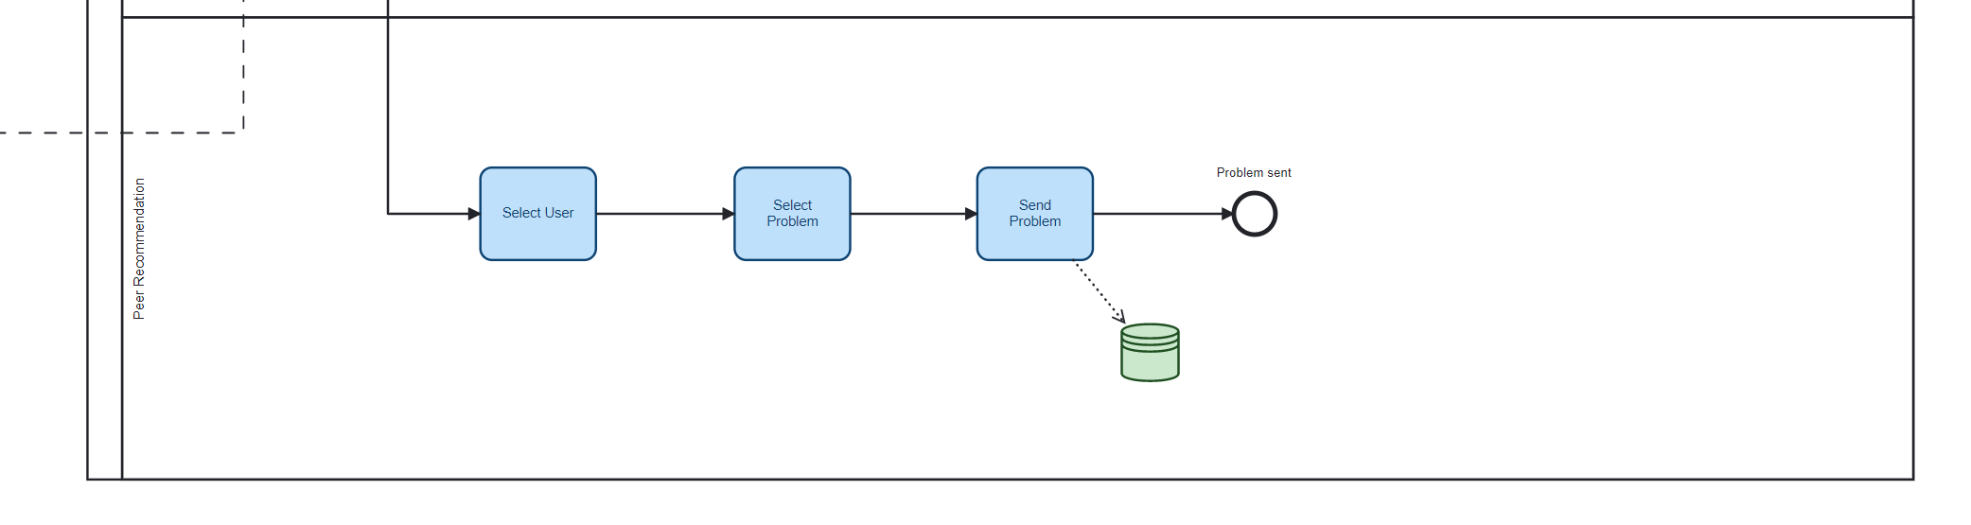
Peer Recommendation

Slide 12
Full BPMN Diagram

